Slide 1
Human resources management terminology
Dr- Slaouti Hanane
University Blida 2

Slide 2
What Is Human Resources (HR)?
Human resources (HR) is the division of a business that is charged with finding, recruiting, screening, and training job applicants. It also administers employee benefit programs.
HR plays a key role in helping companies deal with a fast-changing business environment and a greater demand for quality employees in the 21st century.

Slide 3
Key takewayes
Human resources (HR) is the division of a business responsible for finding, recruiting, screening, and training job applicants.
HR departments also handle employee compensation, benefits, and terminations.
Human resource management (HRM) strategies focus on actively advancing and improving an organization's workforce with the long-term goal of improving the organization itself.
HR departments must keep up to date with laws that can affect the company and its employees.
Many companies have moved traditional HR administrative duties such as payroll and benefits to outside vendors.

Slide 4
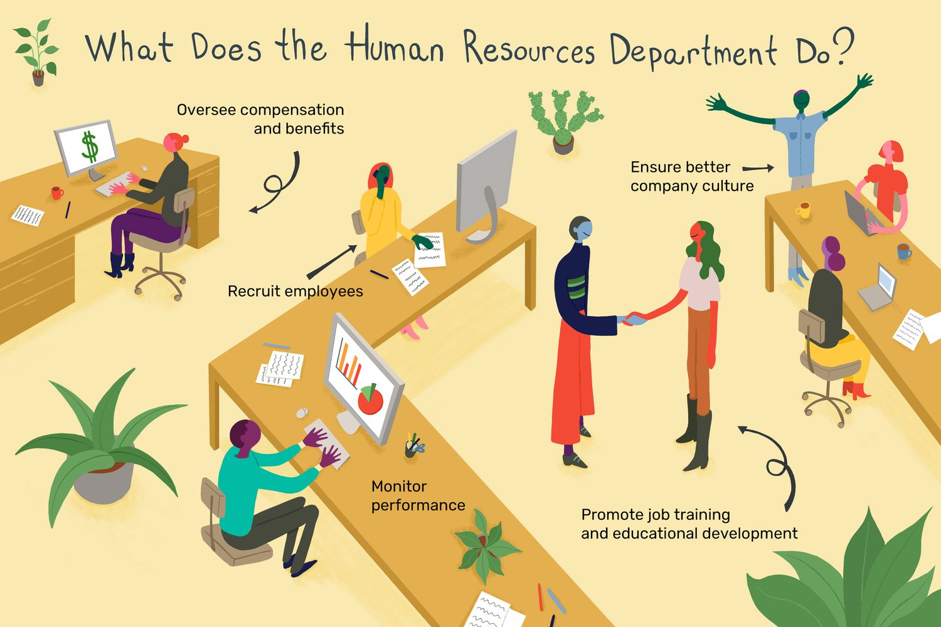

Slide 5
What is human resource management (HRM)?
Human resource management (HRM) is the practice of recruiting, hiring, deploying and managing an organization's employees. HRM is often referred to simply as human resources (HR). A company or organization's HR department is usually responsible for creating, putting into effect and overseeing policies governing workers and the relationship of the organization with its employees. The term human resources was first used in the early 1900s, and then more widely in the 1960s, to describe the people who work for the organization, in aggregate.
HRM is employee management with an emphasis on employees as assets of the business. In this context, employees are sometimes referred to as human capital. As with other business assets, the goal is to make effective use of employees, reducing risk and maximizing return on investment (ROI).

Slide 6
The importance of human resource management
The purpose of HRM practices is to manage the people within a workplace to achieve the organization's mission and reinforce the corporate culture. When people management is done effectively, HR managers can help recruit new employees who have the skills to further the company's goals. HR professionals also aid in the training and professional development of employees to meet the organization's objectives.
A company is only as good as its employees, making HRM a crucial part of maintaining or improving the health of the business. Additionally, HR managers monitor the state of the job market to help the organization stay competitive. This could include ensuring compensation and benefits are competitive, events are planned to keep employees from burning out and job roles are adapted based on the market.

Slide 7
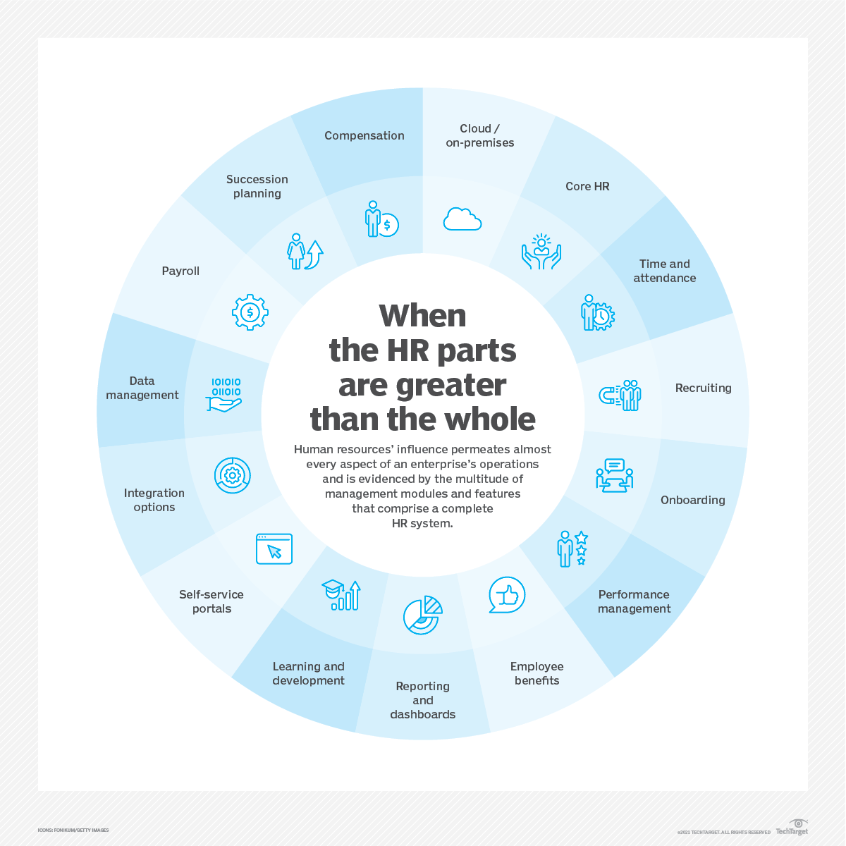

Slide 8
How does HRM work?
HR professionals manage the day-to-day execution of HR-related functions. Typically, human resources is a standalone department within an organization.
HR departments vary in the size, structure and nature of their individual positions. For small organizations, one HR generalist might perform a broad array of functions. Larger organizations have several HR professionals who handle specialized roles, such as recruiting, immigration and visas, talent management, employee benefits and compensation. Though these HR positions are specialized, job functions might still overlap.

Slide 9
Objectives of human resource management
HRM can be broken down into the following four category objectives:
Societal objectives. These are measures put in place to respond to the ethical and social needs or challenges of the company and its employees. This includes legal issues such as equal opportunity and equal pay for equal work.
Organizational objectives. These are actions taken to ensure organizational efficiency, including providing the appropriate training, hiring the right number of employees for a given task and maintaining high employee retention rates.
Functional objectives. These are the guidelines used to keep HR functioning properly within the organization. They include ensuring all HR resources are allocated to their full potential.
Personal objectives. These are the resources used to support the personal goals of each employee. They include opportunities for education and career development, as well as maintaining employee satisfaction.

Slide 10
More specific objectives of HRM include the following:
Provide and maintain productive employees.
Make full use of the skills and abilities of each employee.
Ensure employees have and receive the proper training.
Build and maintain a positive employee experience with high satisfaction and quality of life, so that employees can contribute their best efforts to their work.
Communicate company policies, procedures, rules and regulations to employees.
Maintain ethical, legal and socially responsible policies and behaviors in the workplace.
Manage internal and external changes that might affect employees and staffing.

Slide 11
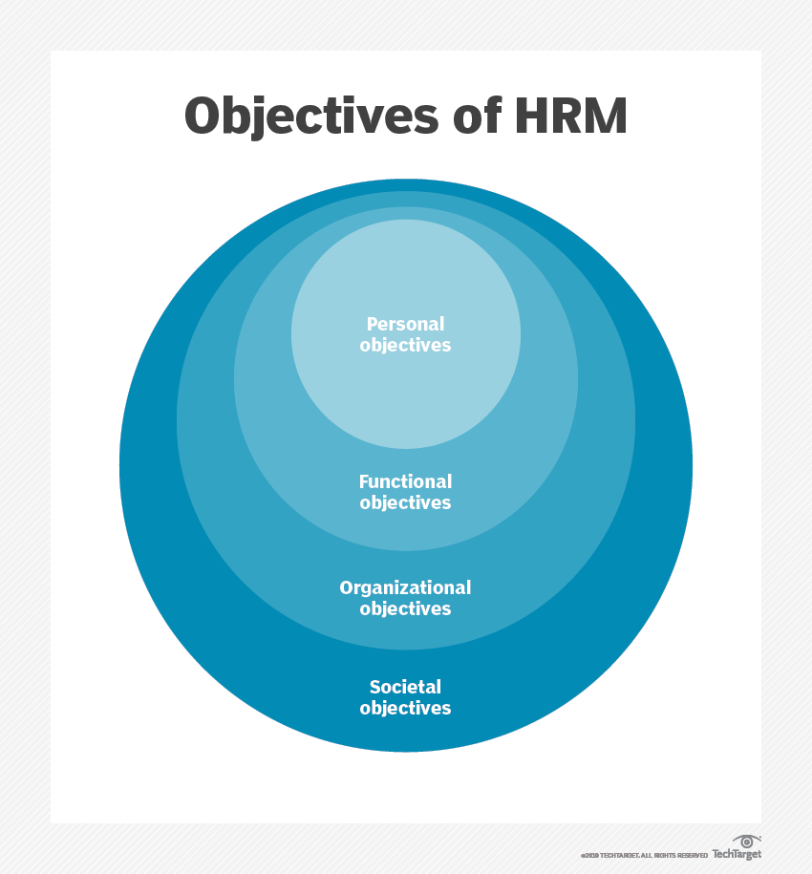

Slide 12
هيكـــل الدراســـــة
أهم أدوات التحليل المالي المستخدمة في في تشخيص الوضعية المالية للمؤسسة الإقتصادية
الفصل الأول
عرض مختلف النماذج المستعملة في التنبؤ بمدى نجاح أو فشل المؤسسة الإقتصادية
هيكل البحث
الفصل الثاني
وسائل وطرق بناء النماذج الكمية للتنبؤ بالوضعية المستقبلية للمؤسسة الإقتصادية
الفصل الثالث
بناء نموذج كمي للتنبؤ بالفشل المالي للمؤسسات الإقتصادية الجزائرية
الجزء التطبيقي

