Slide 1
University of Blida 2 Faculty of Arts and Languages Department of English Module: Educational Psychology for Adolescents
Level: M2 Academic Year: 2022/2023 Teacher: Ms. KELAM

Slide 2
Taxonomies of Learning Domains
The growth theory is among the psychological studies that were interested in human’s growth and changes throughout the life span.
It is mainly a result of the interaction of biological, cognitive, and socio-emotional processes.

Slide 3
Taxonomies of Learning Domains
Aim?
To understand and to overcome the human’s developmental challenges and transitions as well as to deal appropriately with different situations
This scientific theory triggered the attention of many psychologists Piaget‚ Vygotesky and Erikson

Slide 4
Piaget’s Theory
According to Jean Piaget, cognitive development of adolescents moves from concrete to abstract thinking.
Jean Piaget’s Theory of Development is considered as one of the most important theories in developmental psychology.
He believed that all individuals pass through the same four stages in order to progress from one stage to the next, a person must meet the goals of the current stage.

Slide 5
Piaget’s Theory
His theory is essential for psychopedagogy since he focused his attention on how children know and modify their cognitive structures.
Educationalists are often inspired by Piaget’s four (4) stages of development.
Those stages are used in teaching programs because learning should go hand in hand with the learner's cognitive development.

Slide 6
Piaget’s Developmental Theory
1- The sensorimotor stage marks the first two years of life. In this stage, babies learn about and experiment with the physical world. Object permanence and language development are important goals in this stage.
2- The preoperational stage typically lasts until about the age of 7. During this stage, children learn to use symbolic thinking to deepen their understanding of various concepts.

Slide 7
Piaget’s Developmental Theory
3- Children between the ages of 7 and 12 are usually in the concrete operational stage, where they are likely to demonstrate logic and increased reasoning.
4- The final stage, formal operational, typically begins around the age of 13 and lasts through adulthood. This stage is characterized by the understanding of abstract concepts.

Slide 8
Vygotsky’s Theory
Lev Vygotsky is known for his social-cultural theory, which posits that development begins on the social level when children learn from caregivers, teachers, and peers.
Thus, the culture a person is born into has a significant effect on his/ her development.

Slide 9
Vygotsky’s Theory
Unlike Piaget's notion that children’s development must necessarily precede their learning, Vygotsky argued:
"learning is a necessary and universal aspect of the process of developing culturally organized, specifically human psychological function" (1978, p. 90).
In other words, social learning tends to precede (i.e., come before) development.

Slide 10
Vygotsky’s Theory
Vygotsky's theory is comprised of concepts such as culture-specific tools, private speech, and the Zone of Proximal Development.
Vygotsky's theories stress the fundamental role of social interaction in the development of cognition as he believed strongly that community plays a central role in the process of "making meaning."

Slide 11
Vygotsky’s Theory
Unlike Piaget's notion that childrens' development must necessarily precede their learning, Vygotsky argued,
"learning is a necessary and universal aspect of the process of developing culturally organized, specifically human psychological function" (1978, p. 90).
In other words, social learning tends to precede (i.e., come before) development.

Slide 12
Vygotsky’s Theory
Vygotsky's theory focuses on the role of culture in the development of mental abilities e.g. speech and reasoning in children.
According to Vygotsky, adults in society foster children’s cognitive development by engaging them in challenging and meaningful activities.
The interactions with others significantly increases not only the quantity of information and the number of skills a child develops, it also affects the development of higher order mental functions such as formal reasoning.

Slide 13
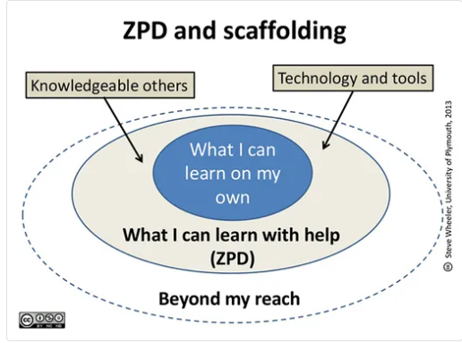
Zone of Proximal Development
Vygotsky consequently focuses on social interaction as an aid to learning; arguing that, left alone, children will develop - but not to their full potential.

Slide 14
Vygotsky’s Ideas
Vygotsky places more emphasis on culture and social factors affecting cognitive development.
Vygotsky places more (and different) emphasis on the role of language in cognitive development.
According to Vygotsky adults are an important source of cognitive development.

Slide 15
Erik Erikson
Erik Erikson (1956) is another important figure in the field of developmental psychology.
He was interested in both individual development (how a person develops a sense of self) as well as a person’s social/cultural identity (the roles played within one's family and in society)
His stage theory is based on his belief that every individual passes through eight stages of development over the course of their life.

Slide 16
Erik Erikson Theory
Erikson maintained that personality develops in a predetermined order through eight stages of psychosocial development, from infancy to adulthood.
During each stage, the person experiences a psychosocial crisis which could have a positive or negative outcome for personality development.
These crises are of a psychosocial nature because they involve psychological needs of the individual conflicting with the needs of society.

Slide 17
Erikson’s Stages of Development
In the initial stage of trust vs. mistrust, infants with consistent and reliable caregivers typically gain a sense of trust and confidence.
During the stage of autonomy vs. shame (age 1-3), children typically develop new skills and begin to learn how to tell right from wrong.
The initiative vs. guilt stage (3-5) is characterized by mimicry of adults and exploration of the world through play. Conflict with parents is typically resolved through the process of social role identification.

Slide 18
Erikson’s Stages of Development
4. The industry vs. inferiority stage (6-12), also known as the latency stage, is a highly social stage. Children who feel inadequate or inferior to their peers may develop self-esteem issues or struggle with competency.
5. Adolescents (12-18) begin to experience identity vs. role confusion. In this stage, their development begins to depend largely on their own actions as they begin to discover and express their identity.

Slide 19
Erikson’s Stages of Development
6. In the intimacy vs. isolation stage (18-34), individuals typically begin to desire intimate relationships and lasting connections with friends and romantic partners.
7. Generativity vs. self-absorption (35-55/65) is most often marked by dedication to career, work, and family. Some individuals may find it difficult to maintain a sense of purpose during life transitions such as retirement or children moving out.

Slide 20
Erikson’s Stages of Development
During the final stage of integrity vs. despair (55/65-end of life), people tend to reflect on life and begin to make peace with the idea of death. Some may develop a sense of integrity as they look back, but others may get "stuck" on certain experiences and failures and feel a sense of despair.
Failure to successfully complete a stage can result in a reduced ability to complete further stages and therefore a more unhealthy personality and sense of self.

Slide 21
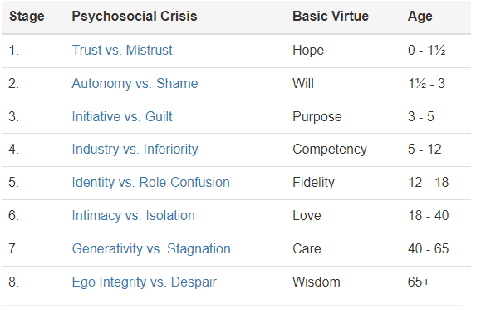

Slide 22
How can one use these theories in the English Language Classroom?
Implication for teaching?
Teacher-Learner interaction?
Psychological support?

